Slide 1
A Hands On Python Interpreter and IDLE Tutorial
By Doug Purcell

Slide 2
What’s the goal of this presentation?
To learn how to use the Python Interpreter as a souped calculator
What are breakpoints, and how to add them
How to step through a program using the IDLE debugger
How to use the IDLE debugger to observe how a program changes during execution
To get hands on experience debugging in Python using IDLE and learning how to use it’s various features.
How to customize the look and feel of IDLE in a couple of clicks

Slide 3
What’s the Python Interpreter?
A tool that comes bundled with your Python installation. It allows you to type input and get output.

Slide 4
How to open the Interpreter
Open up your terminal/command prompt.
Type the following keyword: python
The interpreter should start running.

Slide 5
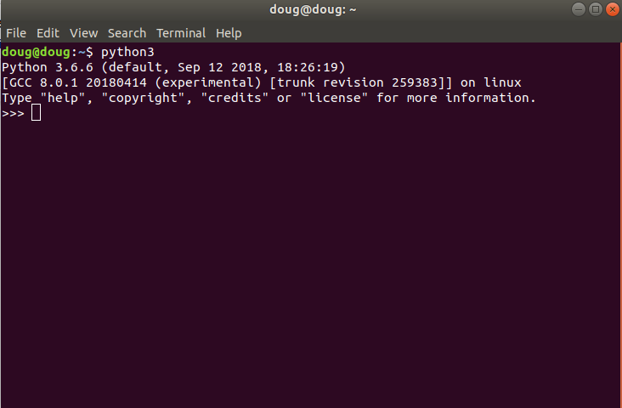
How the Interpreter Looks

Slide 6
Turning the Interpreter into a Super Calculator
>>> 10**75
1000000000000000000000000000000000000000000000000000000000000000000000000000
>>> a = 1
>>> b = 2
>>> c = 3
>>> a + b + c
6
>>> (a+b)**3 + c
30
>>> ((a + b) ** c)
27

Slide 7
Continuation Lines (...)
Are needed when you’re entering in a multiline construct.

Slide 8
Examples of continuation lines
>>> for x in range(1,10):
... if x > 5:
... print(x)
...
6
7
8
9

Slide 9
Exiting from the interpreter
If you want to exit from the interpreter then there are a couple of ways to do this. You can enter the following into the terminal:
quit()
ctr +Z

Slide 10
Exiting Using a Keyboard Shortcut
You could also type the keyboard shortcut of ctr +Z into the Python interpreter.

Slide 11
The Help Module
If you need help learning all of the cool features in Python then you can use the help() function as shown below:
>>> help()
help> modules
help> "antigravity"

Slide 12


The Python Interpreter Quickstart LAB
1) Calculate the values of cos(10) + sin(2) * tan(120). You can do this by using the math module.
2) Calculate the following in Python:
3) Compute the following in the Python interpreter:

Slide 13
Lab Solutions
1) >>> math.cos(10) + math.sin(2) * math.tan(120)
2) >>> math.pi * (4/3)*5**3
3) >>> (10**2 * 250.12791921)/6.2829

Slide 14
Python IDLE
IDLE is the standard Python development environment for Python. If you have Python 2.x or 3.x then IDLE is already bundled with your installation by default.

Slide 15
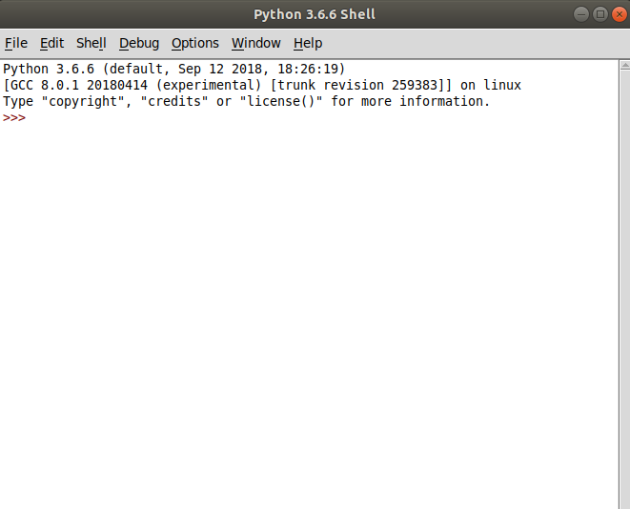
How IDLE Looks

Slide 16
Creating a new File in IDLE
File -> New File
You could alternatively enter the keyboard shortcut: ctr + N

Slide 17
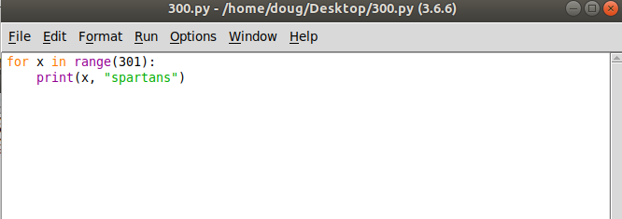
Simple Program in IDLE

Slide 18
Run the File
When you want to run the code you can select Run-> Run Module. Or, you could alternatively type F5.

Slide 19
The IDLE IDE
The Python shell will open up with the output. So, you can use the editor to modify the file, and the shell to view the output.

Slide 20
Python IDLE Debugger
IDLE has a built in debugger which is very useful when you want to step through a program and observe how the program behaves. Before we start debugging in Python download the following program on GitHub: https://bit.ly/2zsywec

Slide 21
Steps for debugging a program in Python
Start IDLE by opening up the terminal and typing the keyword: IDLE
Open up the file you want to debug; in this case Loops.py. Do this by selecting File -> Open, and then locating the file file on your computer
Turn your focus to the Python Shell and select: Debug -> Debugger

Slide 22
Check the Python Shell
>>>
[DEBUG ON]

Slide 23
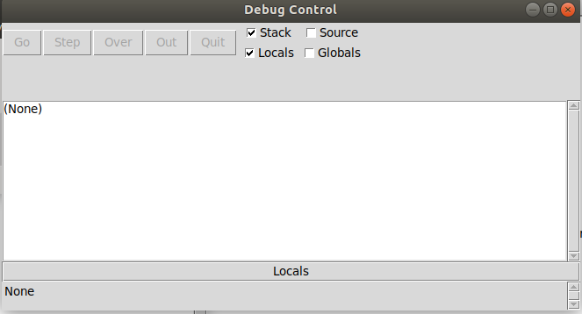
Debug Control Dialog Box

Slide 24
Breakpoints
A breakpoint is a pause in the program execution.
The pause is temporary; helps observe how the program behaves at a certain location
The program resumes normal execution after the breakpoint.

Slide 25
How to add a breakpoint in IDLE
Highlight the portion of the code in which you want to insert a breakpoint at.
Right click.
Select “Set Breakpoint”
The segment which now serves as the breakpoint should be highlighted with yellow.

Slide 26
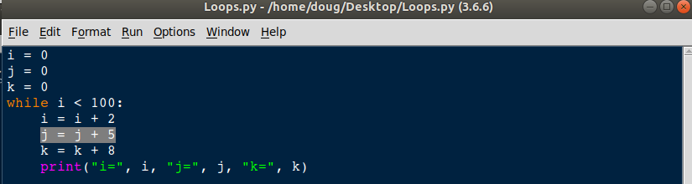
Highlight this portion of the code

Slide 27
Right click
Select Set Breakpoint

Slide 28
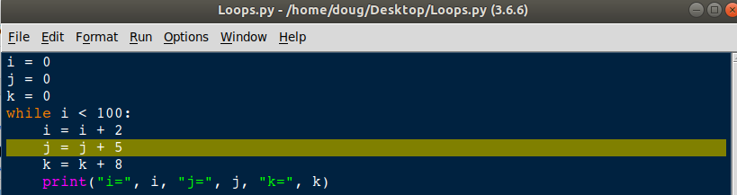
The breakpoint should be highlighted

Slide 29
Step through the program
In Loops.py click Run -> Run Module, or F5.
The Debug Control dialog box should open up.
This is where you can step up until the breakpoint.

Slide 30
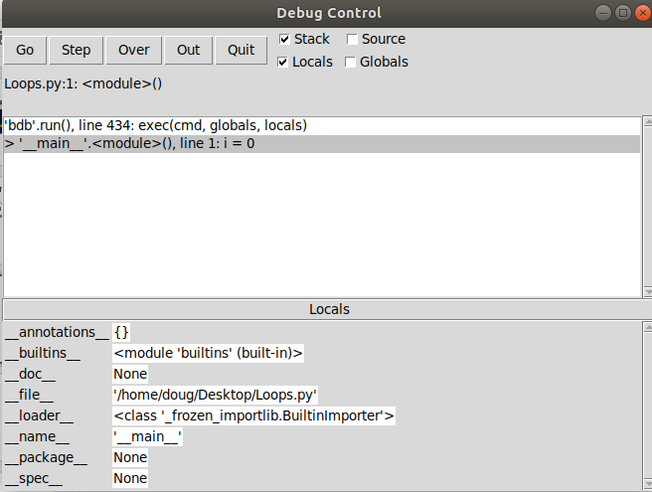
This is how the dialog box looks

Slide 31
To go to line 2 click step
The debugger starts at the first line. To execute the statement click step.
Once done the program should go to line 2 and the dialog box should show that.
This means that the first statement has been executed and the debugger is now pointing to the second line in the program or j = 0

Slide 32
Step until you return to the program beginning
Keep stepping through the program until you return to line 4 again.
Since the variables are already defined the debugger doesn’t start at the first line again. It instead skips to line 4.

Slide 33
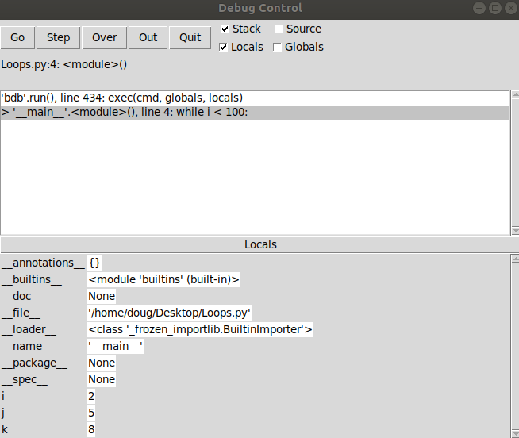
Observe the debugger now

Slide 34
Notice how the variables update?
The variables now show i = 2, j = 5, k = 8
The variables update as the program is stepped through.

Slide 35
Speeding things up
So stepping through the program takes a gazillion clicks. Let’s say that we don’t want to inspect every step. What can we do?
Get out!

Slide 36
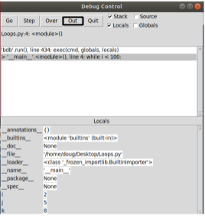
Click the “Out” button

Slide 37
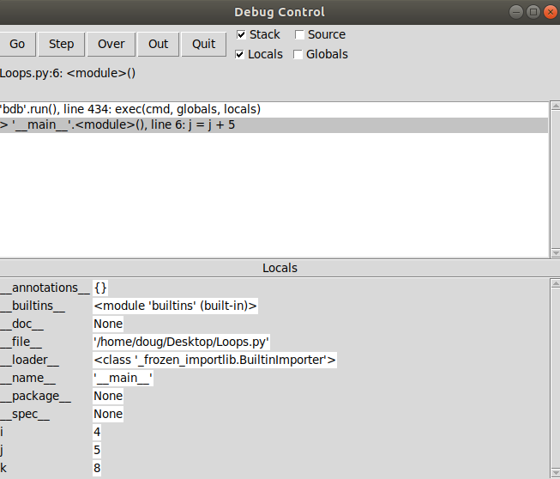
Observe the Debug Control

Slide 38
What updated?
The program updated up until the breakpoint.
Press Out 5X times and observe how the variables update

Slide 39
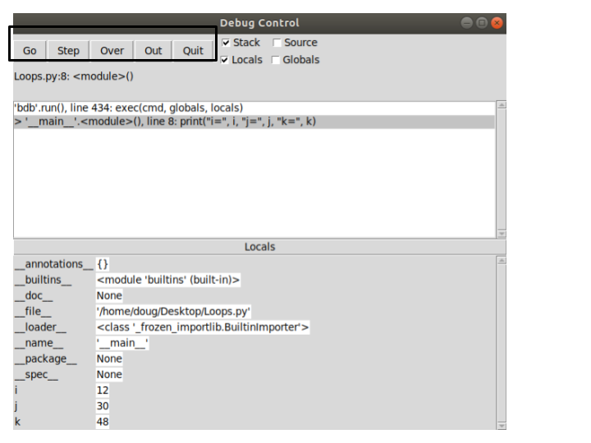
Understanding the debugger options

Slide 40
Debugger Options Explained
Go: Runs the program at normal speed until a breakpoint is encountered.
Step: Execute one line of code.
Over: If control is in a function, step over the function and return control to the human.
Out: Assumes you’re in a function’s call. Finish executing it and step out of the function.
Quit: Close the debugger.

Slide 41
Let’s debug a program that reads in input
Download the simple guessing game file on GitHub here: https://bit.ly/2DnxFzM
This program randomly generates a number between 1-100 and prompts the user to enter a number providing feedback on each guess. The program terminates once the right number is guessed.

Slide 42
Setup GuessingGame.py with IDLE
Open up IDLE by firing up the terminal and typing IDLE
Find GuessingGame.py and then open it in IDLE
In the Python Shell select Debug -> Debugger
On GuessingGame.py set a breakpoint on line 4
In GuessingGame.py hit Run -> Run Module.

Slide 43
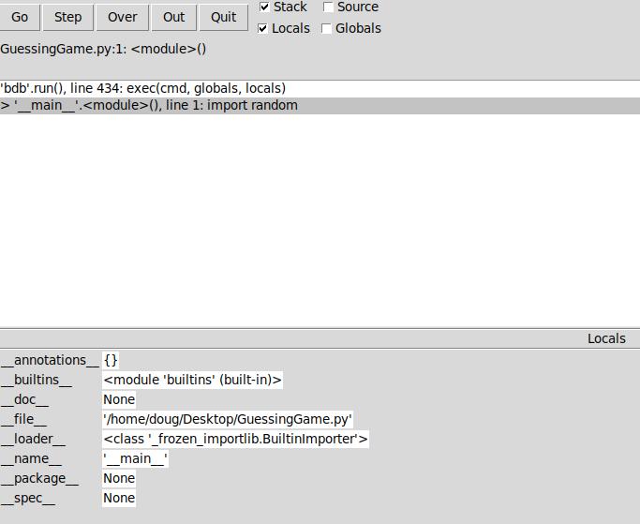
How the debugger should look

Slide 44
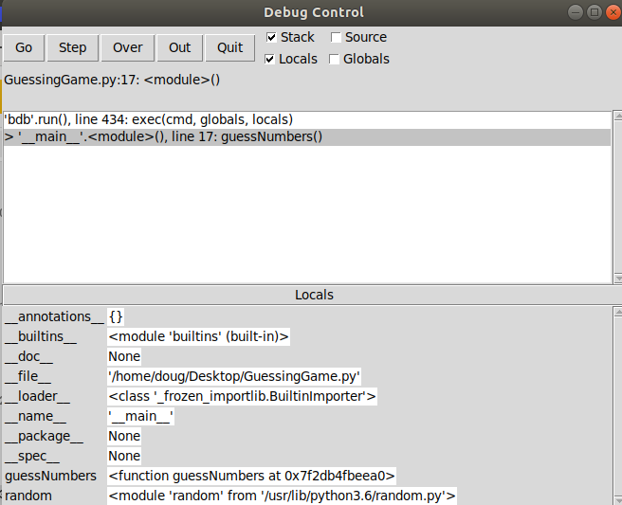
Hit step 2x

Slide 45
Debugger jumps to line 17?
YES. That’s where the function is called

Slide 46
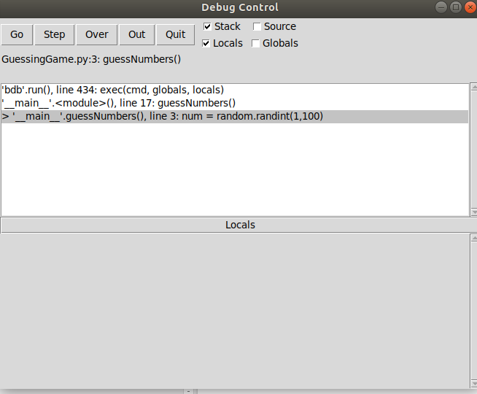
Hit step 1x

Slide 47
Debugger jumps from line 17 to 3
Analyze GuessingGame.py. This is the first statement of the function.

Slide 48
Hit step 1x
Something strange happens.
Program jumps to line 221. Wat? I thought the program is only 17 lines.

Slide 49
Time to investigate
Observe the debugger: ‘random’.randint(), line 221: return self.randrange(a,b+1)
Highlight that statement in debugger, right-click, and then select “Go to source file” random.py

Slide 50
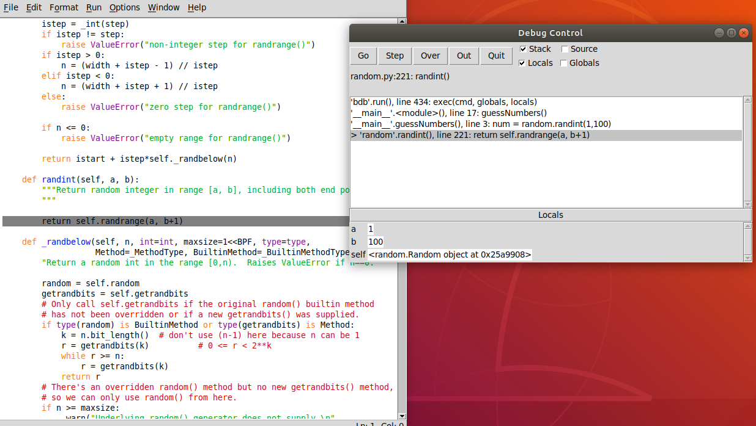
Random.py

Slide 51
Hit Over 2x
The program should appear to hang but it’s simply waiting for you to enter input. Go ahead and play the game
Once you guess the right number the debugger should show you the variables of num, tries, and your_num

Slide 52
Customizing IDLE IDE
If you want to give your IDLE install a facelift then you can customize its appearance. Go to options -> configure IDLE -> Highlights

Slide 53
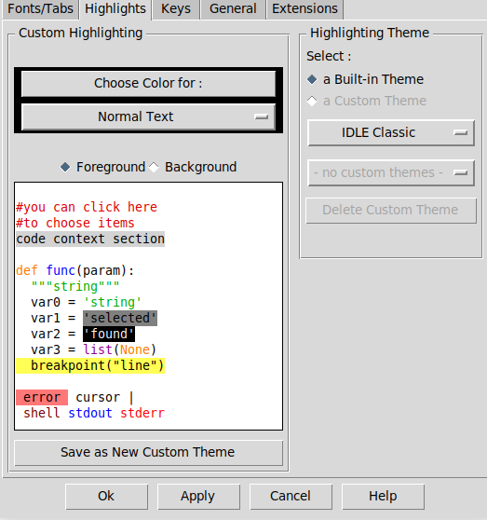
Click on IDLE Classic Button and then IDLE Dark

Slide 54
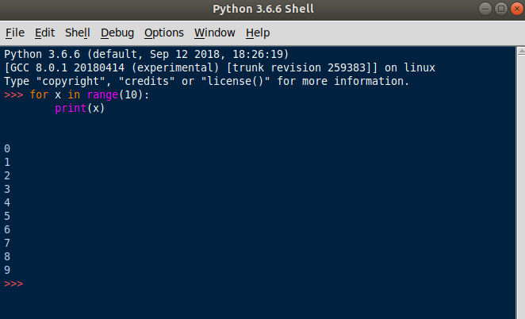
Booyah!

Slide 55
Thanks for being an awesome audience :)

Slide 56
Presentation Brought to you by...
Doug Purcell
Connect with me on LinkedIn: https://www.linkedin.com/in/doug-purcell
Check out my website: http://www.purcellconsult.com
Check out my book on Amazon: “Become a Python Developer”

